Slide 1

Design of a 1420 MHz Bandpass Filter for Radio Astronomy
By: Logan Spooner, Shantanu Chakraborty

Slide 2
Outline
Background and Premise
Methods
Design and Simulation
Construction
Testing and Results
Use in Software Defined Radio

Slide 3
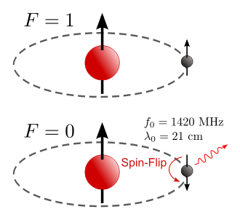
Background and Premise
21 cm wavelength radiation emitted by cold Hydrogen Clouds
Cold Hydrogen is that which makes up most of the Inter Stellar Medium (ISM)
Background noise can hinder the detection of this signal, especially for amateur astronomers.
Our goal was to create an efficient bandpass filter to reduce this background noise using a microstrip structure.

Slide 4
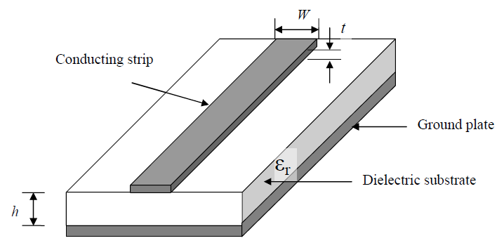
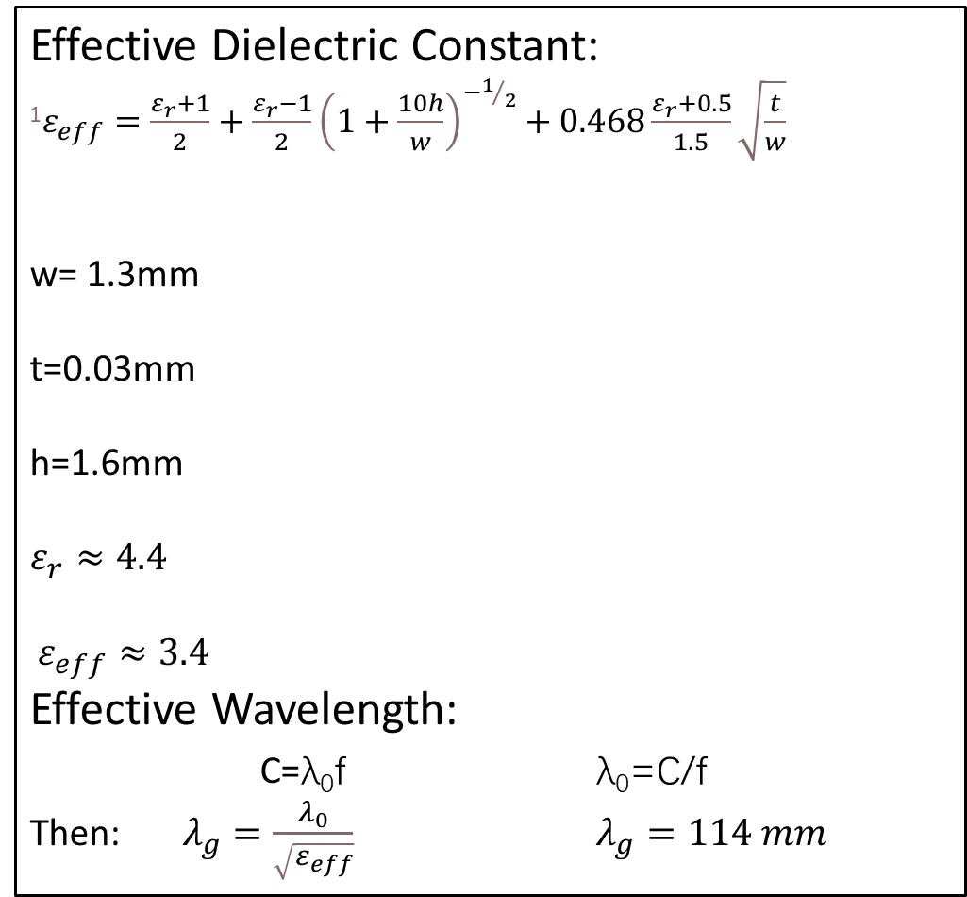
Methods
Effective Dielectric Constant:
¹$ε_{eff}=\frac{ε_{r}+1}{2}+\frac{ε_{r}−1}{2}{\left(1+\frac{10h}{w}\right)}^{−1/2}+0.468\frac{ε_{r}+0.5}{1.5}\sqrt{\frac{t}{w}}$
w= 1.3mm
t=0.03mm
h=1.6mm
$$ε_{r}≈4.4$$
$ε_{eff}≈3.4$
Effective Wavelength:
C=λ₀f λ₀=C/f
Then: $λ_{g}=\frac{λ_{0}}{\sqrt{ε_{eff}}}$ $λ_{g}=114 mm$
Design: Sonnet EM Simulation Software
Material:
FR-4 (PCB material)
Copper Tape
Precision knife
Analysis:
Used Sonnet to analyze designed BPF
Used VNA to analyze constructed BPF

Slide 5
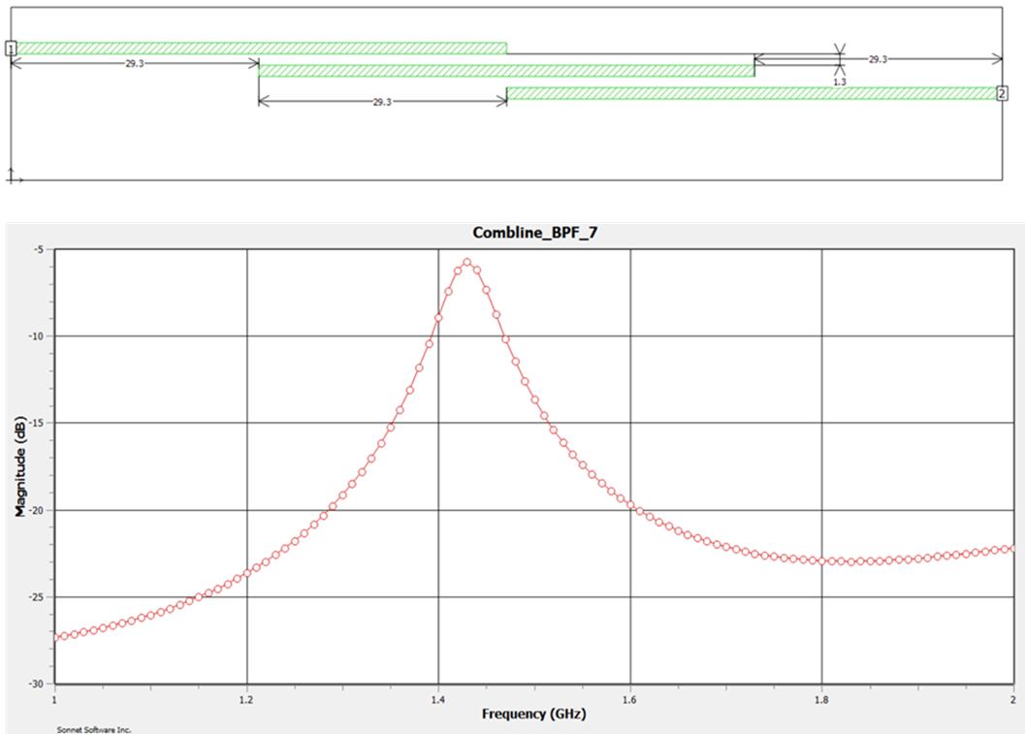
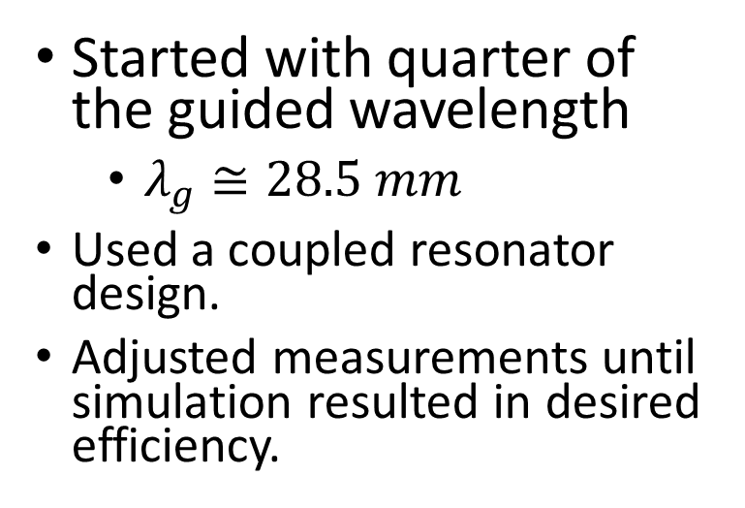
Design and Simulation
Started with quarter of the guided wavelength
$λ_{g}≅28.5 mm$
Used a coupled resonator design.
Adjusted measurements until simulation resulted in desired efficiency.
EM Wave representation of Line-Coupled resonator:

Slide 6
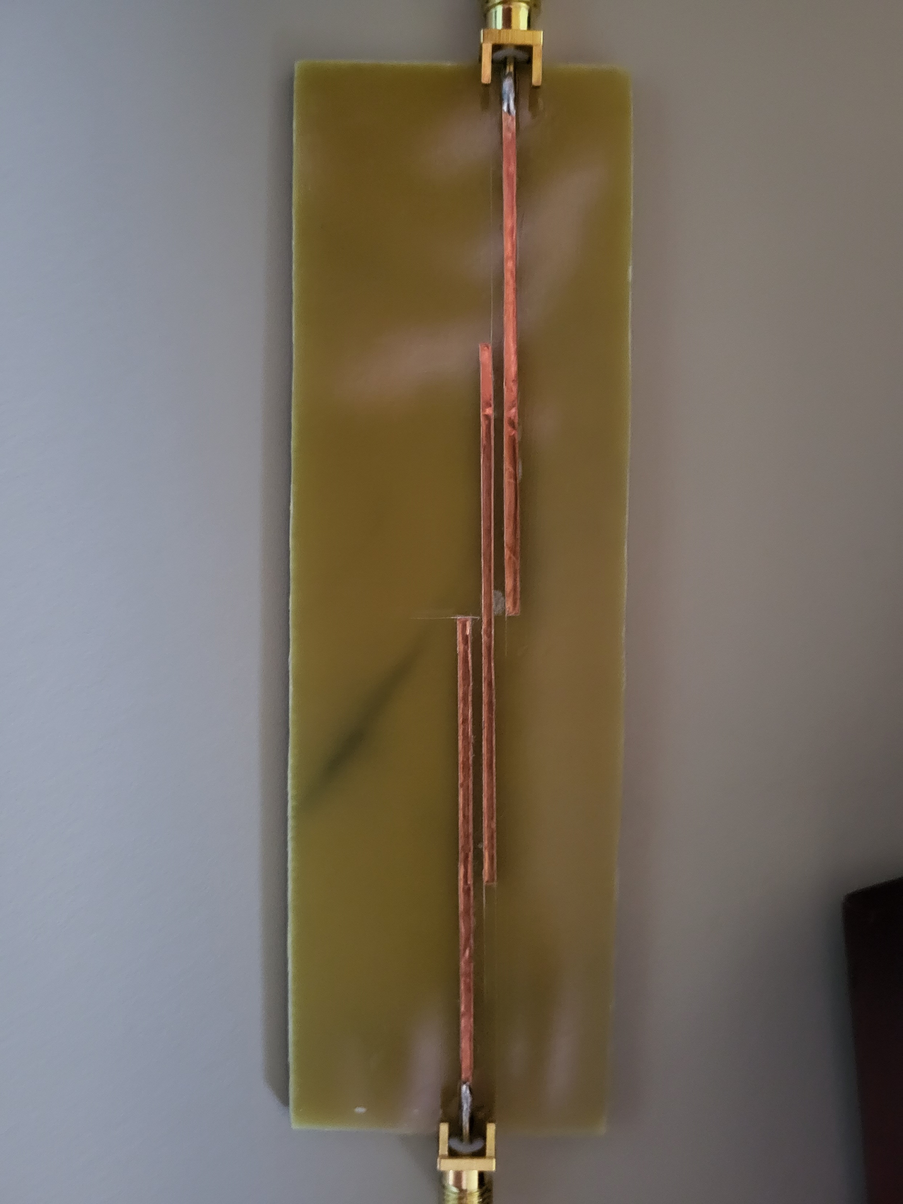
Construction
FR-4 PCB utilized as dielectric and copper tape for microstrip circuit design.
Cost efficient and widely available materials.
Easily implemented design using Calipers and a Precision Knife.
Soldered 50ohm SMA connectors.

Slide 7
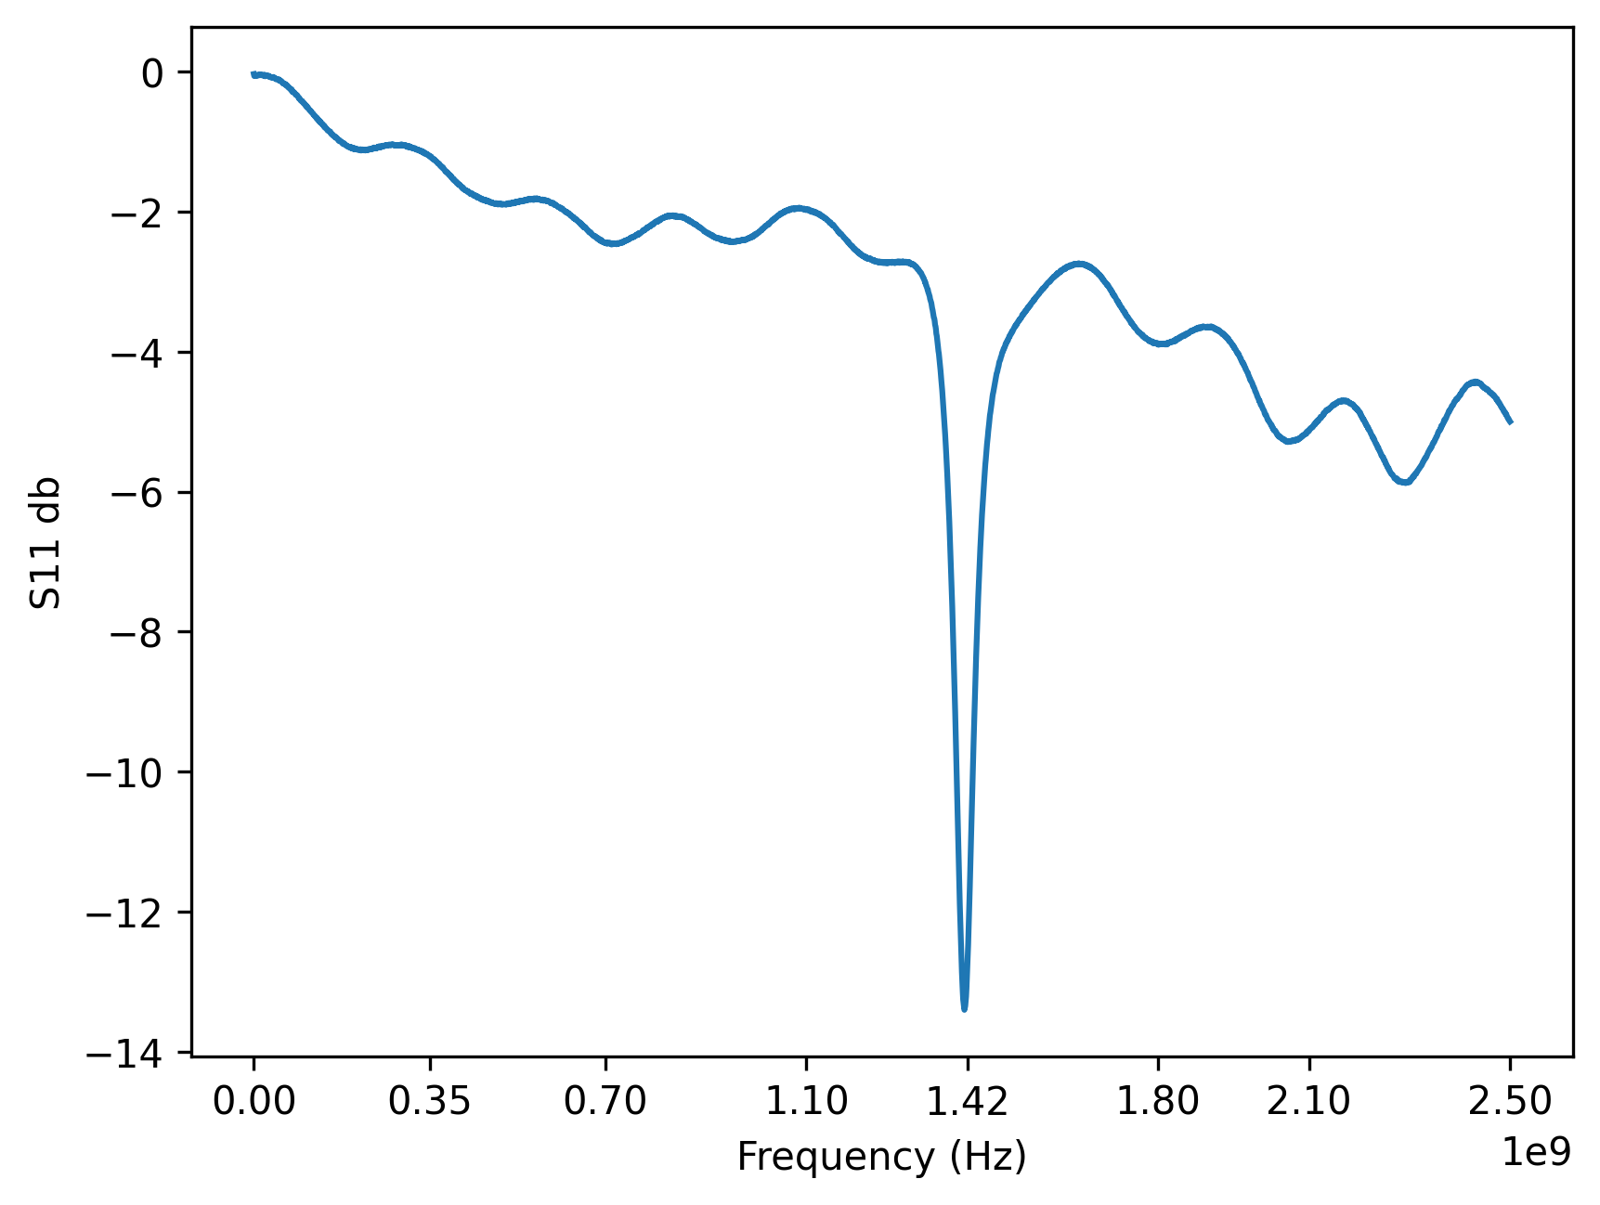
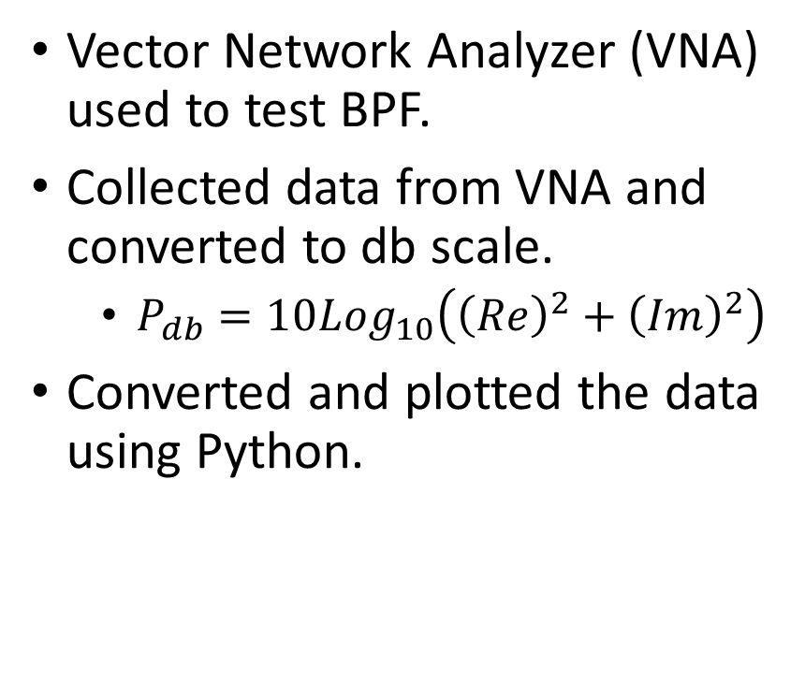
Testing and Results
Vector Network Analyzer (VNA) used to test BPF.
Collected data from VNA and converted to db scale.
$P_{db}=10Log_{10}\left({\left(Re\right)}^{2}+{\left(Im\right)}^{2}\right)$
Converted and plotted the data using Python.
Sharp peak at 1.42 GHz shows a high S11 (reflection) loss at our desired frequency. This suggests a high transmission of signal across the BPF for target frequency and high reflection for other signals.

Slide 8
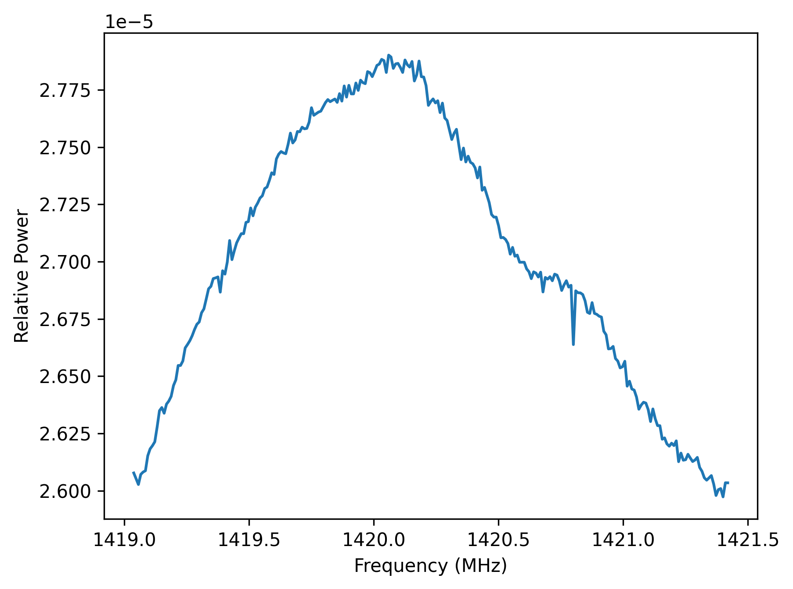
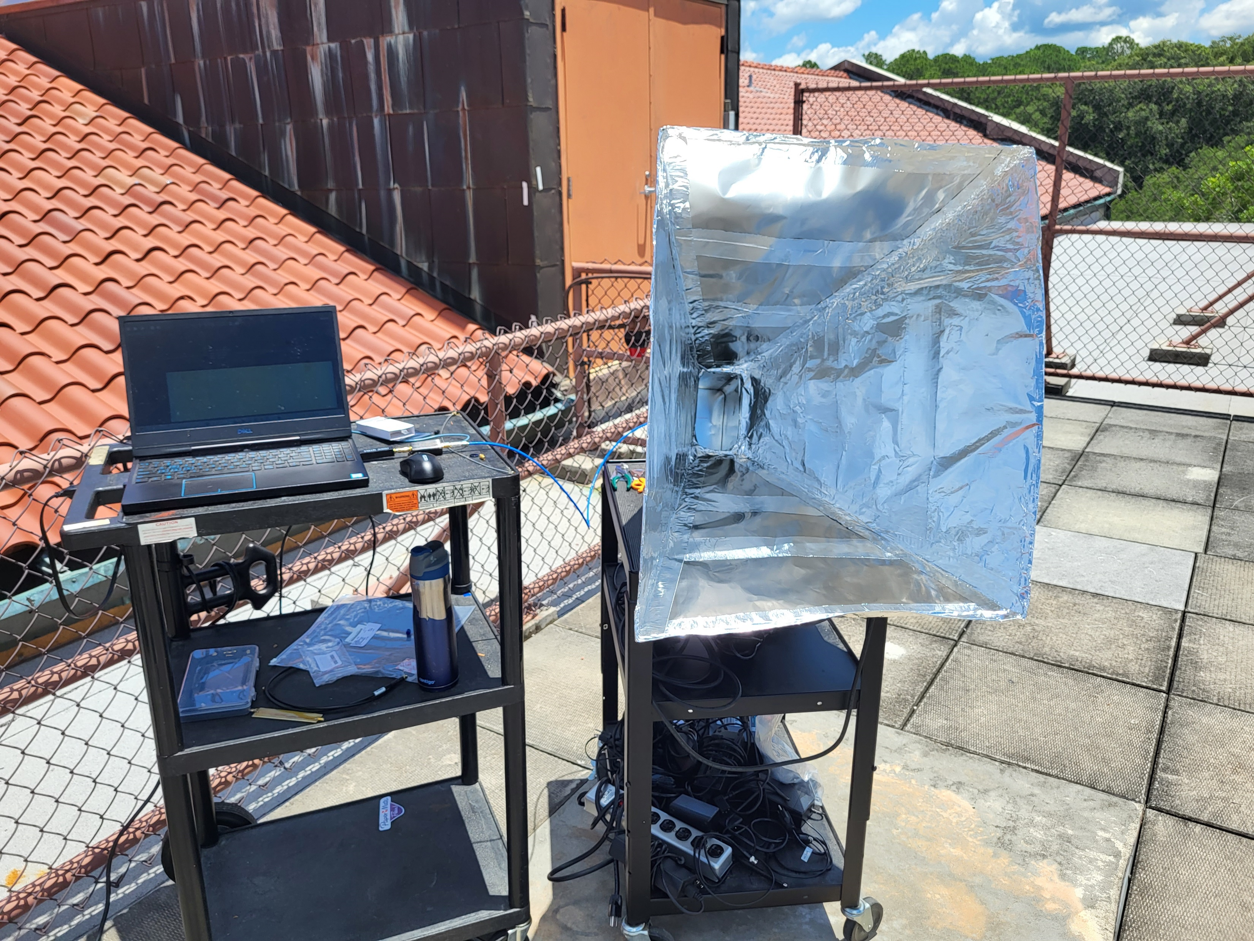
Use in Software Defined Radio Telescope
Connected in series with horn antenna, Low noise amplifier, and RTL-SDR to collect 1420 MHz signal near Cygnus.
Used SDR# and IFAve plugin to compute FFT
Analyzed 8 data sets taken over 6 minutes each.

Slide 9
Acknowledgements
This project was supported by the Blazer Summer Research Institute program of Valdosta State University

Slide 10
Sources
J. Bahl and R. Garg, "Simple and accurate formulas for a microstrip with finite strip thickness," in Proceedings of the IEEE, vol. 65, no. 11, pp. 1611-1612, Nov. 1977, doi: 10.1109/PROC.1977.10783.
A. Garg, B. Pratap and D. Gupta, "Design of Parallel Coupled Line Band Pass Filter," 2016 Second International Conference on Computational Intelligence & Communication Technology (CICT), Ghaziabad, India, 2016, pp. 452-454, doi: 10.1109/CICT.2016.96.
Zhekai Chen 2022 J. Phys.: Conf. Ser. 2381 012080

